Slide 1



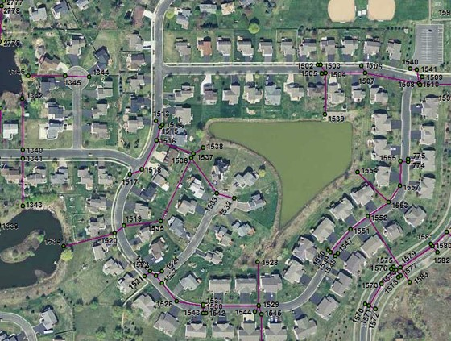
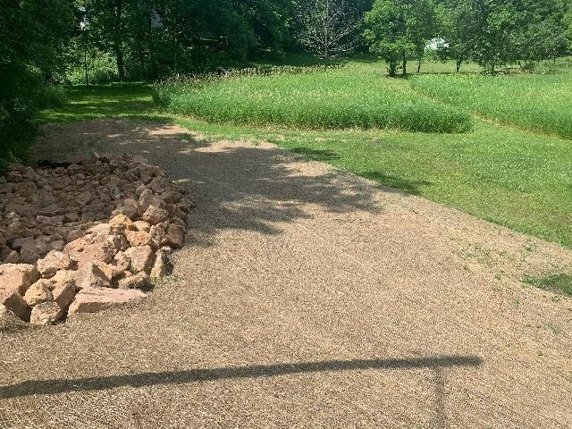
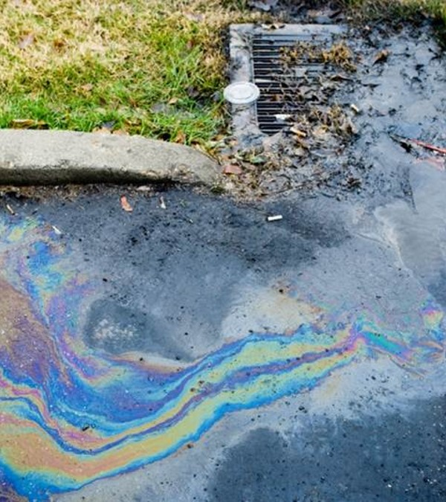
Minnesota Pollution Control Agency (MPCA)
National Pollutant Discharge Elimination System(NPDES)
Municipal Separate Storm Sewer System (MS4) Permit
2019 MS4 Overview
Minimum Control Measure 1
Public Education and Outreach
Informational material available on City website
Newsletters distributed
Activities included: Spring Clean Up Event, Fall Yard Waste Cleanup, Partnerships with Clean Water MN
Minimum Control Measure 6
Pollution Prevention and Good Housekeeping
Quarterly Public Works inspections and maintenance
Public works staff training
Completed required inspections for stormwater infrastructure:
  BMP inspections – 4
  Outfall inspections - 18
  Pond Inspections - 8
  BMP maintenance
Minimum Control Measure 2
Public Participation and Involvement
MS4 Annual Meeting held on November 18, 2019
Minimum Control Measure 3
Illicit Discharge Detection and Elimination
Documentation and response to an illicit discharge
Illicit discharge enforcement action
  Two (2) illicit discharges reported in 2019
City field staff received illicit discharge training
2020 MS4 Program Goals
Continue to offer educational materials and opportunities to citizens about the MS4 program, pollution prevention practices, and other information regarding stormwater.
Increase education, monitoring, and enforcement regarding illicit discharge.
The new MS4 General Permit was issued November 16, 2020. Required updates to Excelsior’s program are currently in the works and will align with the new reauthorization.
Minimum Control Measure 4 & 5
Construction Site Stormwater Runoff Control
Post-Construction Stormwater Management
Three (3) active construction sites greater than 1 acre
39 site inspections completed in 2019
One (1) enforcement action (verbal warning)

