Slide 1


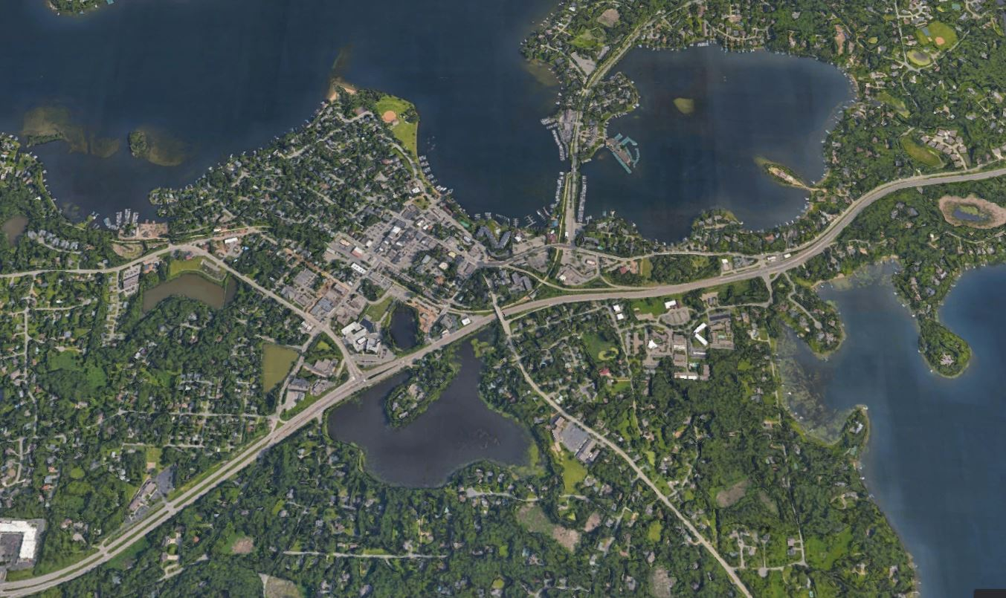
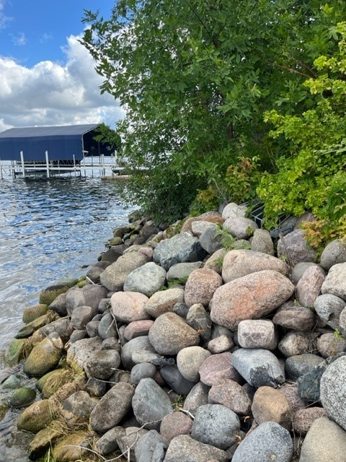
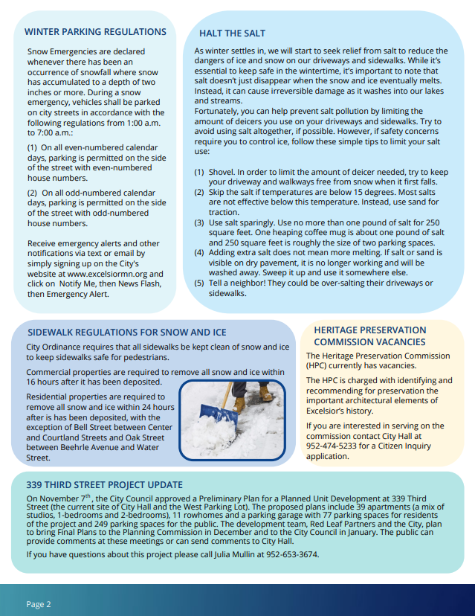
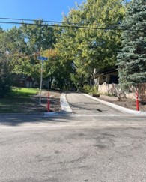
Minnesota Pollution Control Agency (MPCA)
National Pollutant Discharge Elimination System(NPDES)
Municipal Separate Storm Sewer System (MS4) Permit
2022 MS4 Overview
Minimum Control Measure 1
Public Education and Outreach
Informational material available on City website
Newsletters distributed to residents & businesses
The city held annual spring clean up and fall yard waste clean up alongside continued partnership with Clean Water MN
Minimum Control Measure 6
Pollution Prevention and Good Housekeeping
Quarterly Public Works inspections and maintenance
Public works staff training
Completed required inspections for stormwater infrastructure:
BMP inspections – 21
Outfall inspections - 20
Pond Inspections - 7
BMP maintenance as needed
Minimum Control Measure 2
Public Participation and Involvement
MS4 Annual Board was published for the month of December 2022 on the City’s webpage
Minimum Control Measure 3
Illicit Discharge Detection and Elimination
Documentation and response to an illicit discharge
Illicit discharge enforcement action
One (1) illicit discharge reported in 2022
City field staff received illicit discharge training
2023 MS4 Program Goals
Continue to offer educational materials and opportunities to citizens about the MS4 program, pollution prevention practices, and other information regarding stormwater. Excelsior’s focus of education will be Residential Best Management Practices and Yard Waste topics
Increase education, monitoring, and enforcement regarding illicit discharge, pet waste, & snow and salt management
Minimum Control Measure 4 & 5
Construction Site Stormwater Runoff Control
Post-Construction Stormwater Management
Four active construction sites greater than 1 acre
23 site inspections completed in 2022
One (1) enforcement action necessary

